Slide 1
Syllabic Affiliation of Prevocalic Glides in Sonoran Spanish Dialectal variation in syllabic affiliation
Sonia Colina¹, Joseph V. Casillas², Yamile Díaz¹
University of Arizona¹, Rutgers University²

Slide 2
Goal
To investigate the syllabic affiliation of prevocalic, post-consonantal glides in Spanish, e.g., ‘i’ in mie.do ‘fear’.
To determine whether prevocalic glides are parsed as a complex onset in some varieties of Spanish.

Slide 3
Background
The standard position in the literature (Harris & Kaisse 1999; Hualde 2005, 2014; Colina 2009, and many others) is that postconsonantal, prevocalic glides are parsed in the nucleus of the syllable, when there is a preceding consonant that occupies the onset, i.e., (1a) rather than (1b) (however, cf. Martínez-Gil 2016 for arguments for 1b)

Slide 4
Background
In most varieties of Spanish, when the glide is prevocalic, but not postconsonantal (i.e., the onset is empty), the glide becomes an obstruent (with various degrees of aperture/constriction, e.g., approximant, fricative, stop, affricate) and it is parsed in the onset, e.g., -iendo [-jen.do] ‘-ing’, com-iendo [ko.mjen.do] ‘eating’, vs. creyendo [kre.ʝen.do] ‘believing’ (Hualde 2005, Colina 2009). In other words, glides are not possible onsets.

Slide 5
Background
That glides are not possible onsets is one of the arguments used to support the nuclear parsing of prevocalic glides.
(Hualde 2005, Colina 2009).
Additional arguments in favor of the nuclear status of prevocalic postconsonantal glides have to do with rhyme restrictions, vowel harmony and hypochoristic formation (cf. Hualde 2014, Colina 2009).

Slide 6
Background
Some Spanish varieties, such as the Spanish of Sonora, Mexico, allow glides in the onset (Canfield 1981, Alvar 1996), i.e., creyendo ‘believing’ [kre.jen.do] (they do not become obstruents).
Consequently, a glide preceded by a consonant (e.g., i in tiara) could in principle be parsed as the second element in the onset [tj] (i.e. an onset cluster), rather than in the nucleus [ja].

Slide 7
Research question/s
RQ1: Is a postconsonantal, prevocalic glide parsed as the second segment of a complex onset in Sonoran Spanish?
RQ2: In more general terms, the question is: are Spanish prevocalic glides always part of a complex nucleus (preceding a full vowel, in a diphthong) or can the glide be parsed in the onset in some dialects?

Slide 8
Research question/s
Onset parsing would suggest cross-dialectal variation in the syllabic affiliation of prevocalic glides.
It is reasonable to assume that dialectal variation could also affect syllabification/syllabic affiliation, but little is known about cross-dialectal variation in Spanish syllabification.
Onset parsing of the prevocalic glide would bear out the predictions of an optimality-theoretic factorial typology in which constraint reranking predicts possible patterns of variation: (i) Onset, *Onset/glide >> *Complex Nuc, Max-IO𝝻, Ident(cons) (nuclear glide) (ii) Onset, *Complex Nuc >> *Onset/glide, Max-IO𝝻, Ident(cons) (onset glide) (Colina 2009).

Slide 9
Experimental design
Oral recorded data
10 speakers of Sonoran Mexican Spanish, 18-25 years old.
Recordings took place in a sound isolated booth using a Shure SM10A Head mounted microphone
Two tasks: (i) oral recorded phrase reading (e.g. “Digo ___ porque sí”) (ii) an oral syllable division task.
Stimuli: a total of 21 nonce words (alongside 21 fillers) with a C+G+V sequence

Slide 10
Experimental design
Two sets of stimuli designed according to two hypotheses.
Set 1, Hypothesis 1:
Spanish only allows a maximum of three rhyme segments (Harris 1983). If a sequence of CGVGC (Consonant + Glide + Vowel + Glide + Consonant) is allowed, the glide should be in the onset, because otherwise the rhyme would contain four segments and would be illicit.
14 four-syllable nonce words that contained a postconsonantal high vocoid followed by a diphthong (four segment rhyme or complex onset + three segment rhyme). lacap[jaj]sto, lacap[waj]sto
Four syllable words were created to avoid a glide + vowel sequence too close to the beginning or end of the word, positions known to favor hiatuses in some dialects (Hualde 1999, 2005).

Slide 11
Experimental Design
Set 2, Hypothesis 2:
If the glide is in the onset, there should be onset co-occurrence restrictions, i.e., only some combinations of consonant + glide should be possible as complex clusters. For instance, a palatal consonant + homorganic glide [j] (e.g., *ch[j]aba, *[jj]ape, *ma[ɲj]ala) should be disallowed because their articulations are too similar.
7 nonce words (not controlled for number of syllables or stress, all with the same G and V for GV, ia)

Slide 12
Results – syllable division task
Questions:
How do participants respond? Is GVG possible?
Does production depend on the glide type or the phonetic environment?
Coding
Triphthong: critical sequence produced in a single syllable
i.e. “lakapiaisto” ⇾ [la.ka.ˈpi̯ai̯s.to]
Hiatus: vowel + diphthong (CV + VGC),
i.e., “lakapiaisto” ⇾ [la.ka.pi.ˈai̯s.to]
Simplification: a segment was elided (typically the pre-vocalic glide)
i.e., “lakapiaisto” ⇾ [la.ka.ˈpai̯s.to]
Analysis
Multinomial mixed-effects regression
Model: response ~ glide_type + preceding_consonant
Random effects: by-subject/by-item intercepts with random slopes glide and preceding consonant
Notes:
The first task examines two main questions:
First, how do participants syllabify the nonce words? Is glide-vowel-glide a possible realization?
Second, are responses predicted by the type of glide or the preceding consonant?
To answer these questions we coded the responses in the following manner:
Triphthong, Hiatus, or Simplification (can read direct from slide)
Explain example word “lakapiasto” for each possible realization
We fit the data using a multinomial mixed-effects model with
response as the criterion and
Glide type and preceding consonant as fixed effects
The model included by-subjects and by-items intercepts with random
slopes for glide_type and preceding consonant
The model found that responses did not vary as a function of the glide type
nor the preceding consonant, so we will look at overall response rates

Slide 13
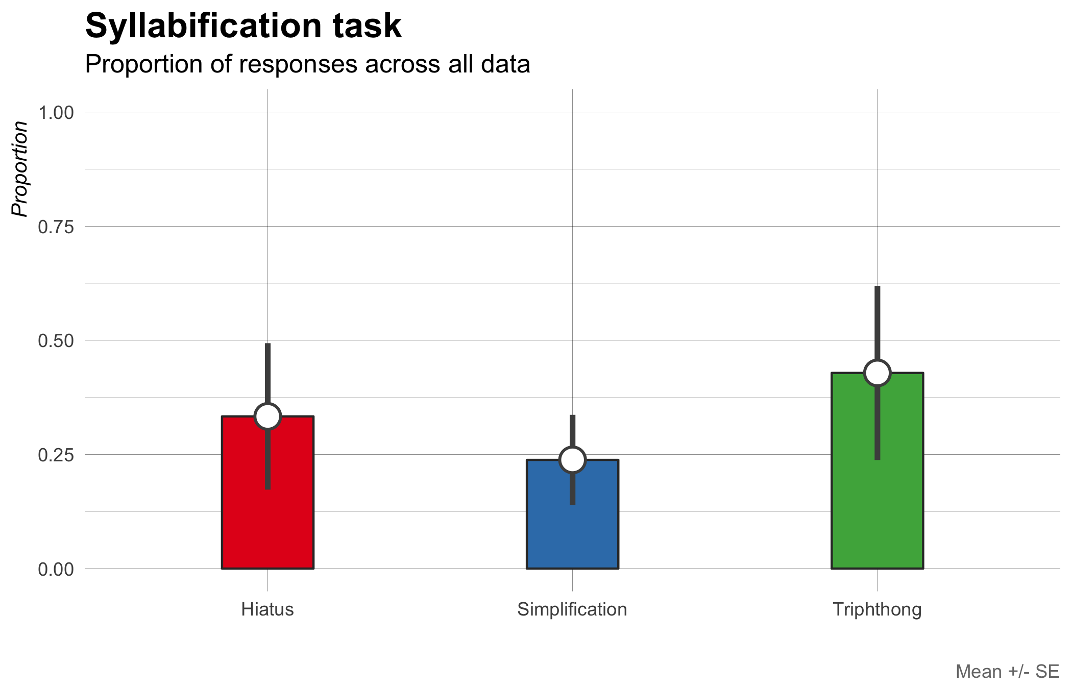
Notes:
Plot: Proportion of responses across all data
We observe that triphthongs were produced in approximately 40% of the targets.
A production containing a hiatus made up roughly 35% of the data, followed by a simplification of some sort (~25% of the time).

Slide 14
Takeaways
Triphthongs were produced in approximately 45% of the targets.
A production containing a hiatus made up roughly 30% of the data, followed by a simplification of some sort (~25% of the time)
Overall, the task provides evidence supporting the hypothesis that pre-vocalic glides can be part of the onset in this variety of Spanish.
Notes:
Main finding: we have evidence supporting the hypothesis that pre-vocalic glides can be part of the onset
Why: because the participants produced triphthongs at least some of the time.
Responses were variable and we cannot account for this variability with glide type nor preceding consonant

Slide 15
Results – phrase reading
Hypothesis: Pre-vocalic glides will be disallowed if preceded by a palatal consonant
Measure duration, F1, and intensity of the pre-vocalic glide in two environments: after a palatal consonant, after any other consonant

Slide 16
Results – phrase reading
If pre-vocalic glides are blocked after palatals (i.e., “lliape”), when compared with pre-vocalic glides that are not preceded by a palatal segment (i.e., “piano”) we expect to observe…
differences in overall duration
formant trajectory differences related to height (F1)
Analysis 1 (duration)
Linear mixed effects model
Model: duration ~ environment
Random effect: by-subject/by-item intercepts with random slopes for preceding consonant
Notes:
Differences in duration: Why? Because something is theoretically elided
Differences in F1: Why? Because in one case (piano) a glide should be
produced without problems and in the other case (lliape) it shouldn’t
thus there should be differences in formant movement between the two conditions:
(F1 correlates with height)
PIANO: formant movement the high vocoid [j] to the low vowel [a]
LLIAPE: if pre-vocalic glide is blocked then we shouldn’t see the same formant movement

Slide 17
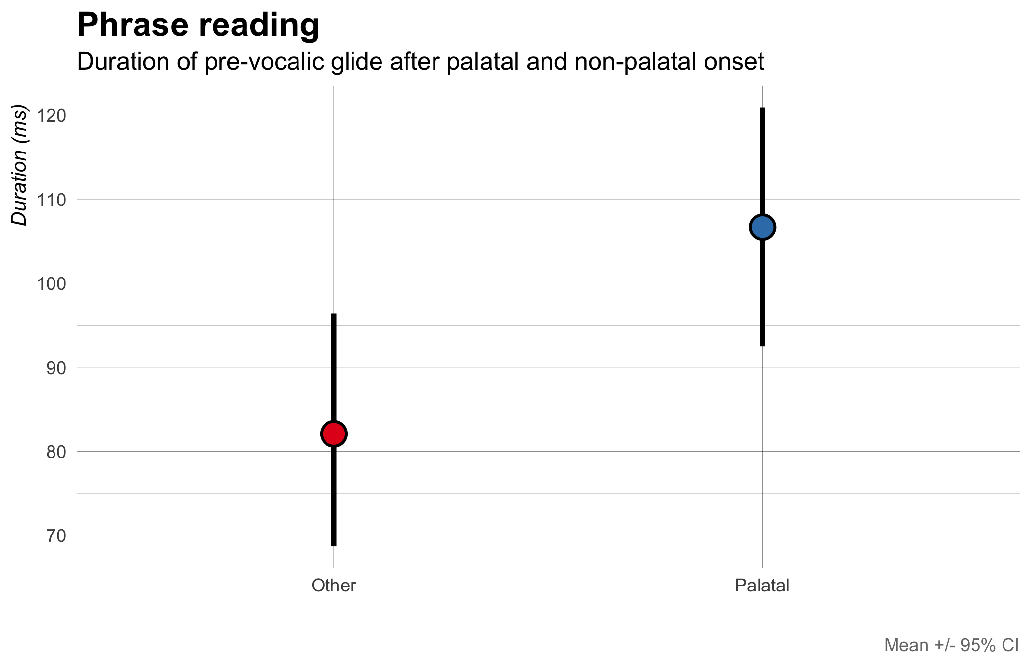
Notes:
This plot shows duration as a function of preceding consonant (palatal vs. non-palatal).
We see a longer duration for glide segments following a palatal consonant (roughly 30 ms longer)
Not exactly expected (intuitively, if glide is blocked, one might expect a shorter duration, at least I did)
But is initially evidence supporting our hypothesis
What about formant trajectories?

Slide 18
Results – phrase reading
If the participants are able to produce a glide in some contexts (piano) but not others (lliape) we should also see differences in F1 as a function of the preceding consonant.
Analysis 2
Generalized Additive Mixed Model
Model: F1 ~ preceding_consonant + time
Reference smooth for time, participant
Difference smooth for preceding_consonant
Notes:
If the participants are able to produce a glide in some contexts (piano, i.e., when there is no palatal onset)
but not others (lliape, when there is a palatal onset)
we should see differences in F1 over time as a function of the preceding consonant (palatal, non-palatal)

Slide 19
Notes:
No effect of preceding consonant: the trajectories are the same over time
Df = 3, p = 0.260
F1 movement similar across contexts.
Does this mean pre-vocalic glides aren’t blocked after palatal consonants?
How do we explain the duration difference?

Slide 20
Results – phrase reading
Participants might be producing a longer segment in the palatal condition because of the fact that they cannot naturally produce both.
In other words, they might be trying to produce something, but because the target is illicit, they resort to lengthening.
Prediction: intensity of the lengthened segment should be lower than that of a glide.
Why? More consonant-like productions have lower intensity than more vowel-like productions.
Analysis 3
Generalized Additive Mixed Model
Model: Intensity ~ preceding_consonant + time

Slide 22
Notes:
Intensity is different for palatal vs. non-palatal preceding consonants after 35% of the time course
The productions are more consonant like (lower intensity) after the palatal

Slide 23
Summary
Sonoran speakers used variable strategies when producing the CGVGC sequences
Importantly, they produced the GVG sequence at least some of the time (thus it is possible)
Acoustic analysis shows that pre-vocalic segments are longer after palatal consonants
Not shorter (i.e., elided because they are blocked)
Analysis of the time course suggests the duration increase could be due to lengthening of onset
Strategy to avoid illicit sequence

Slide 24
Research question/s
RQ1: Is a postconsonantal, prevocalic glide parsed as the second segment of a complex onset in Sonoran Spanish?
A1:Yes, at least some of the time.
RQ2: In more general terms, the question is: are Spanish prevocalic glides always part of a complex nucleus (preceding a full vowel, in a diphthong) or can the glide be parsed in the onset in some dialects?
A2:The glide can be parsed in the onset in dialects like Sonoran Spanish, but it is not categorical

Slide 25
Discussion
Acoustic analysis shows that pre-vocalic segments are longer after palatal consonants, revealing a strategy to avoid an illicit sequence. In the syllabification task, speakers produce triphthongs in 45% of the targets, so onset parsing is possible, but not categorical.
As predicted, onset parsing suggests cross-dialectal variation in the syllabic affiliation of prevocalic glides. Furthermore, the parsing of glides also exhibits dialect-internal variation, as some, but not all glides are in parsed the onset.

Slide 26
Discussion
The rankings predicted by an optimality-theoretic factorial typology are variable/non-categorical: (i) Onset, *Onset/glide >> *Complex Nuc, Max-IO𝝻, Ident(cons) (nuclear glide) (ii) Onset, *Complex Nuc >> *Onset/glide, Max-IO𝝻, Ident(cons) (onset glide) (Colina 2009).
The variable, non-categorical rankings above (underlined) can be modelled in stochastic OT (Boersma and Hayes 2001 )
Further research is needed to study the factors conditioning the variation (they do not appear to be phonological)
This study could be replicated with more subjects (controlled for sex, age, linguistic profile), and, for comparative purposes, also with speakers of dialects that do not allow onset glides.
Notes:
Data without labial + w, without lacap[waj]sto
10 fewer diphthongs (22 >> 12)
5 fewer hiatuses (12 >7)
3 fewer simplification (8 > 5)

Slide 27
Conclusion
In this study we examined the syllabic affiliation of prevocalic glides in Sonoran Spanish
Since glides are licit in the onset (i.e., no onset strengthening in Sonoran Spanish), a postconsonantal, prevocalic glide could be parsed as the second segment of a complex onset in Sonoran Spanish.
Experimental evidence showed that Sonoran speakers produced the GVG sequence at least some of the time (thus it is possible). Acoustic analysis shows that pre-vocalic segments are longer after palatal consonants; the duration increase is shown to be due to lengthening of onset (a strategy to avoid illicit sequence).
Glides can be variably parsed as C2 in a complex onset. Onset glides in Sonoran Spanish provide evidence for cross-dialectal and intra-dialectal variation in syllabic affiliation.

Slide 28
References
Alvar, M. (1996). Manual de dialectología hispánica. Barcelona: Ariel.
Boersma, P. and Hayes, B. 2001. Empirical tests of the Gradual Learning Algorithm. Linguistic Inquiry 32. 45-86.
Boersma, P. & Weenink, D. (2018). Praat: doing phonetics by computer. Version 6.0.39, retrieved 3 April 2018 from http://www.praat.org/.
Canfield, L. (1981). Spanish Pronunciation in the Americas. Chicago: U. of Chicago P.
Colina, S. (2009). Spanish Phonology: A syllabic perspective. Washington, DC: GUP.
Harris, J. W. (1983). Syllable structure and stress in Spanish. Cambridge, MA; MIT Press.
Harris, J. W. and E. M. Kaisse. (1999). Palatal vowels, glides, and obstruents in Argentinian Spanish. Phonology 16.117-190.
Hualde, J. I. (2005). The Sounds of Spanish. Cambridge, UK: CUP.
Hualde, J.I. (2014) La silabificación en español. In Núñez-Cedeño, et al. (Eds.). (2014). Fonología generativa contemporánea de la lengua española. Washington, DC: Georgetown UP, pp. 195-215.

Slide 29
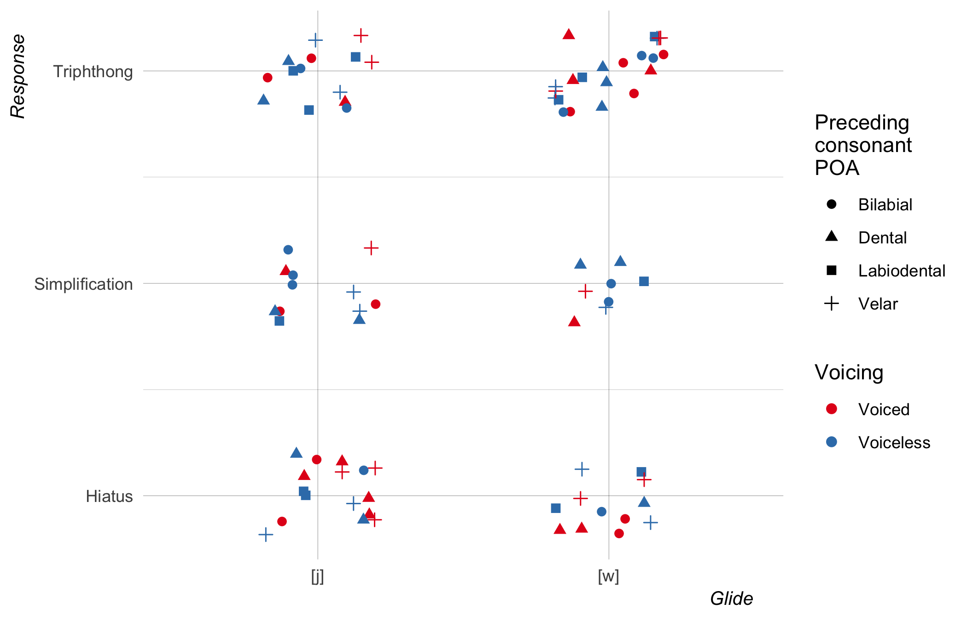
Notes:
EXTRA
Plot: syllabification responses by POA, voicing, and glide type
Glide type doesn’t matter (j is not different from w)
The preceding consonant doesn’t matter (though not easy to see here)
Take away: the responses are pretty equally spread out

Slide 30
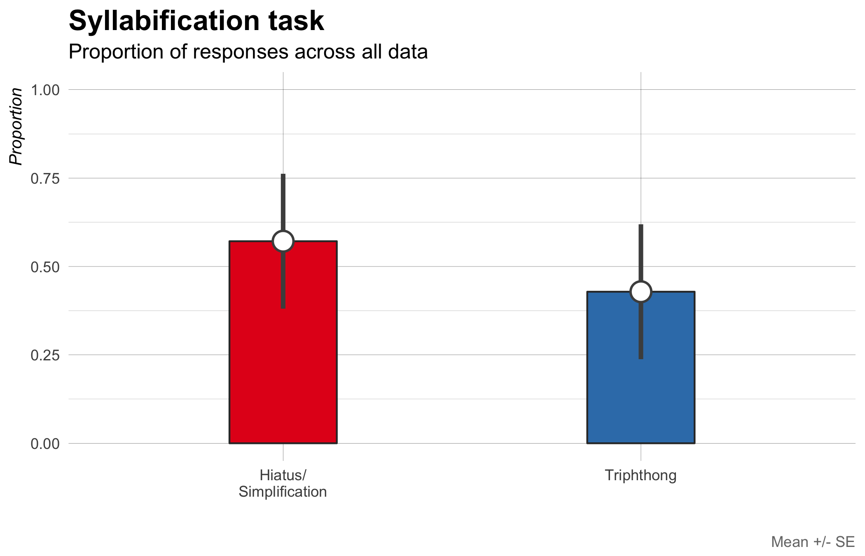
Notes:
Plot: Proportion of responses across all data
If we combine hiatus and simplification (Figure 2), we see that they make up approximately 60% of the data.

